Slide 1
GIS 502 Final Project Presentation
Presenter Name: Zhaokai Guan

Slide 2
Agenda
What is my project topic?
Why did I choose this topic?
How did I conduct this final project?
What are my findings?
Data source and other useful links.

Slide 3
Introductions
My project is focused on analyzing the pattern of traffic accident distributions in Montgomery County, Maryland, US by using GIS analysis tools.
Because I am currently taking part in a machine learning project leading by another data scientist.
I did not want to simply get rid of “latitude” and “longitude” columns because I learned some GIS from this class.
My GIS project can be considered as an add-on or extension of the machine learning project. (a forked repo)

Slide 4
Project Road Map
Data importing
Initial analysis
Pattern recognition
Further Analysis
Findings
Some final thoughts

Slide 5
Data importing
Map -> Add Data -> XY Table To Point
This thing is so powerful, and it auto detects x field and y field because of my column names.
After importing, it looks like this.

Slide 6
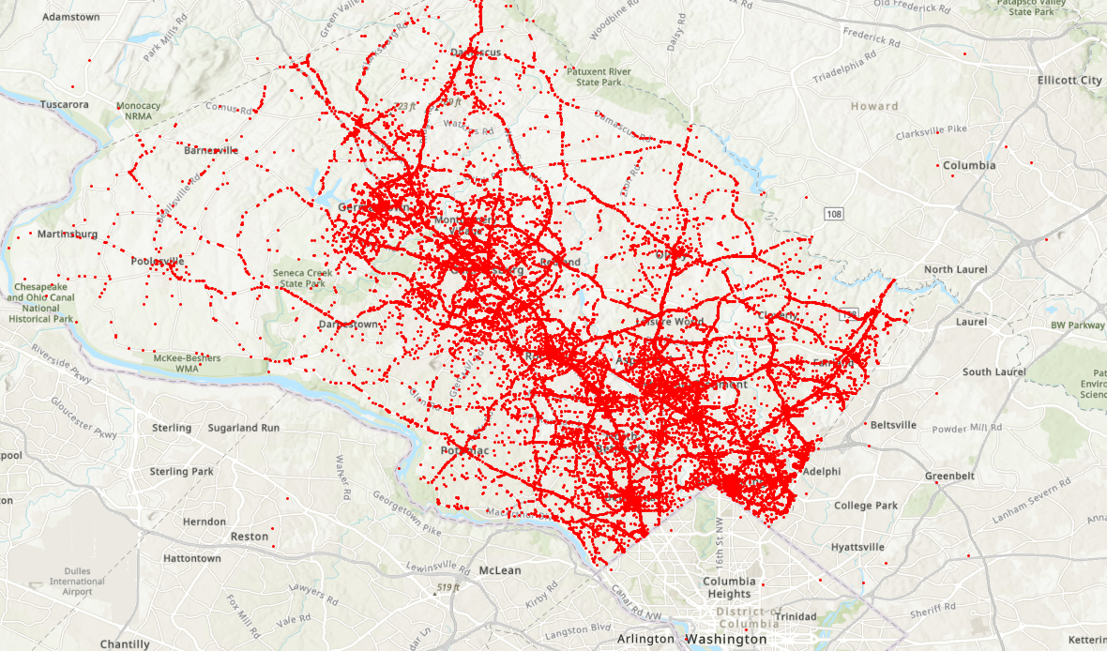
Data importing
Each red dot represents an accident.
The raw data looks like a big yikes.
But can you see some patterns?

Slide 7
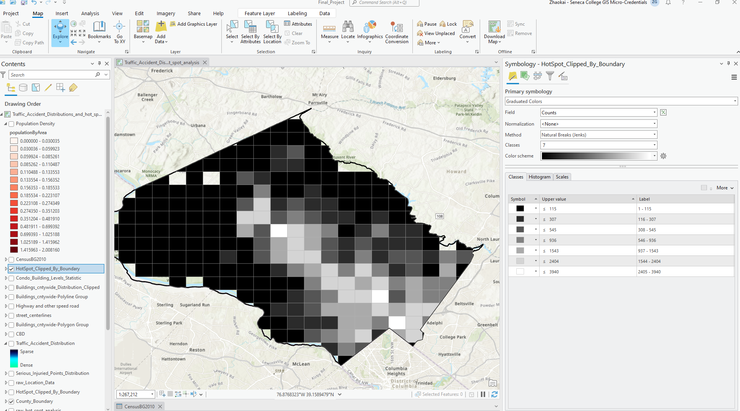
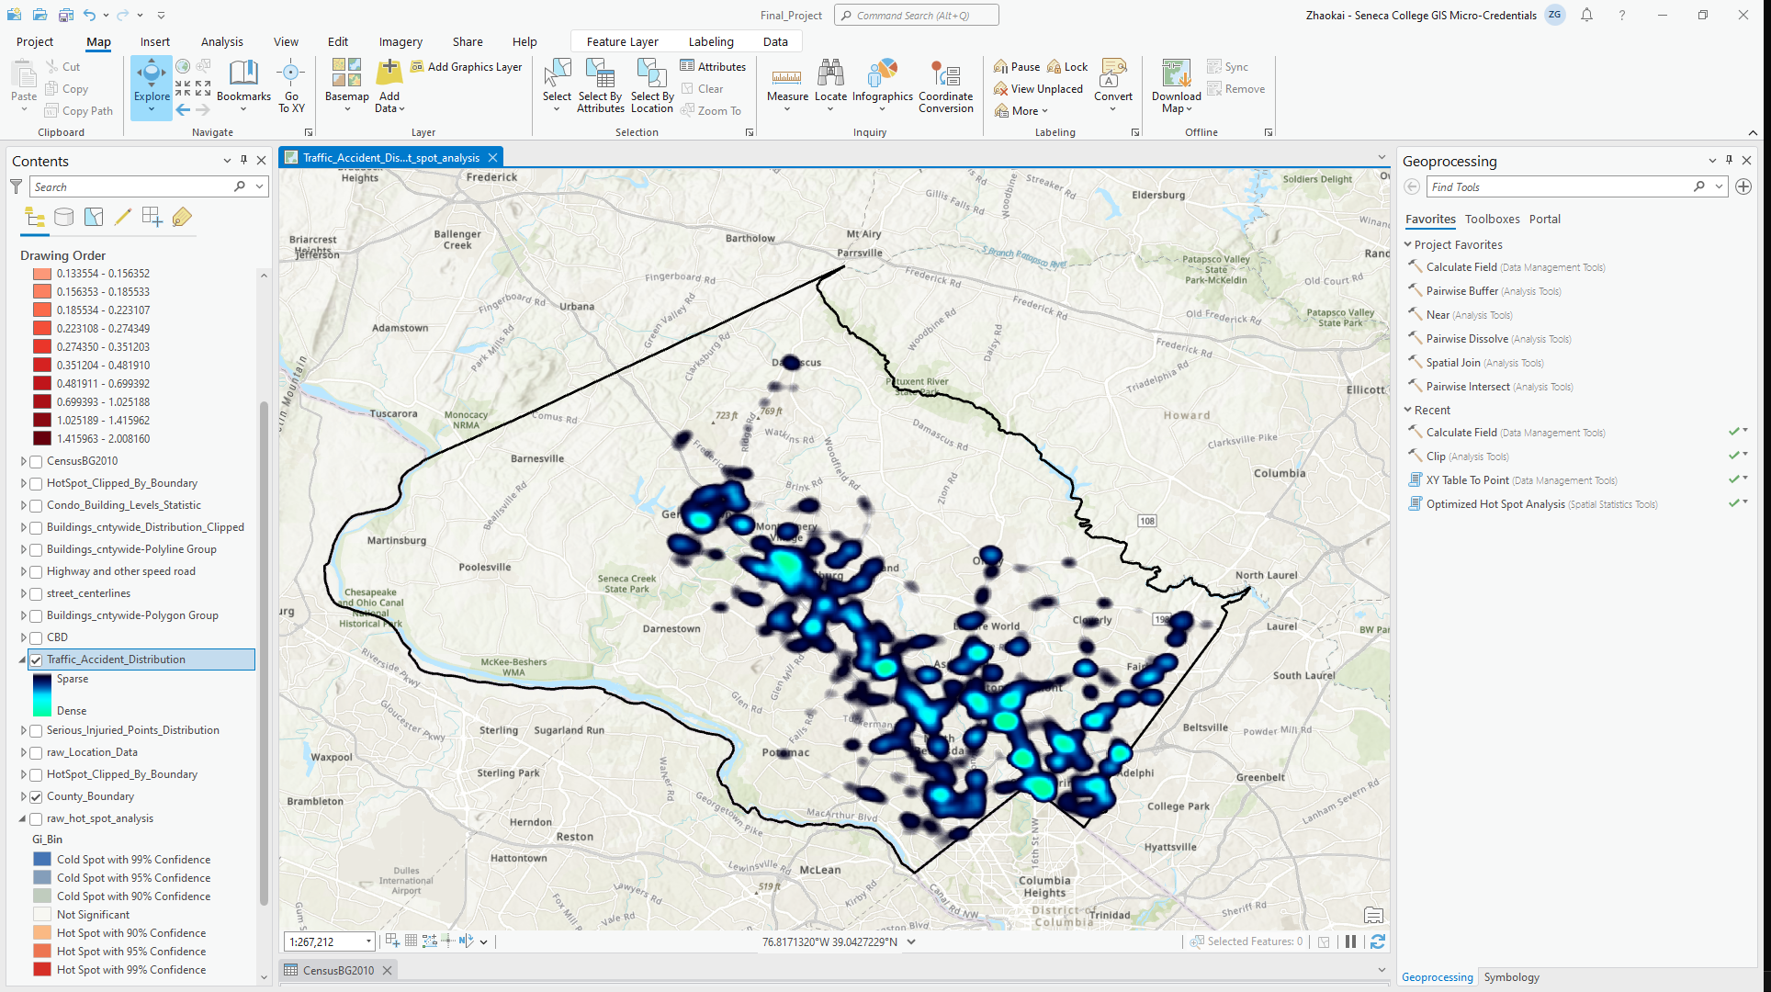
Pattern Recognition
By using Arc GIS heat map, hot spot analysis and clip, the pattern now is much clear.

Slide 8
Pattern Recognition
Now we can see, the traffic accidents hot spot’s distribution seems following a major highway.
Accidents tend to occur more frequently as one approaches Washington DC.

Slide 9
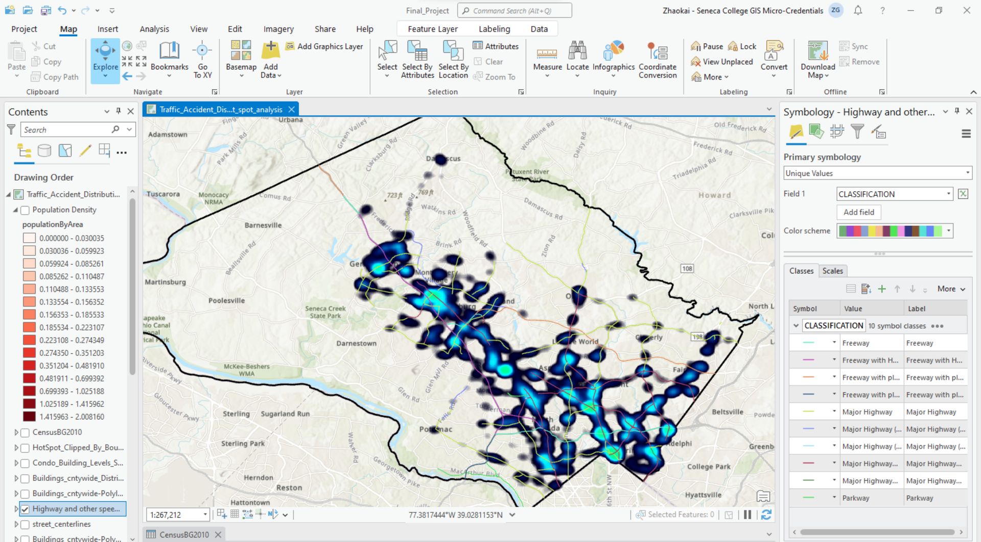
Pattern Analysis
To prove the accident distribution is aligned to the major road’s presence.
Downloaded the GIS asset from Montgomery County public open data.

Slide 10
Pattern Analysis
Population density seems significantly affecting the accident’s distribution pattern.
Downloaded the census GIS data from 2010.
Attribute table -> Add a new column populationPerAreaUnit and do calculation.
Change symbology using graduated colors and Natural breaks.

Slide 11
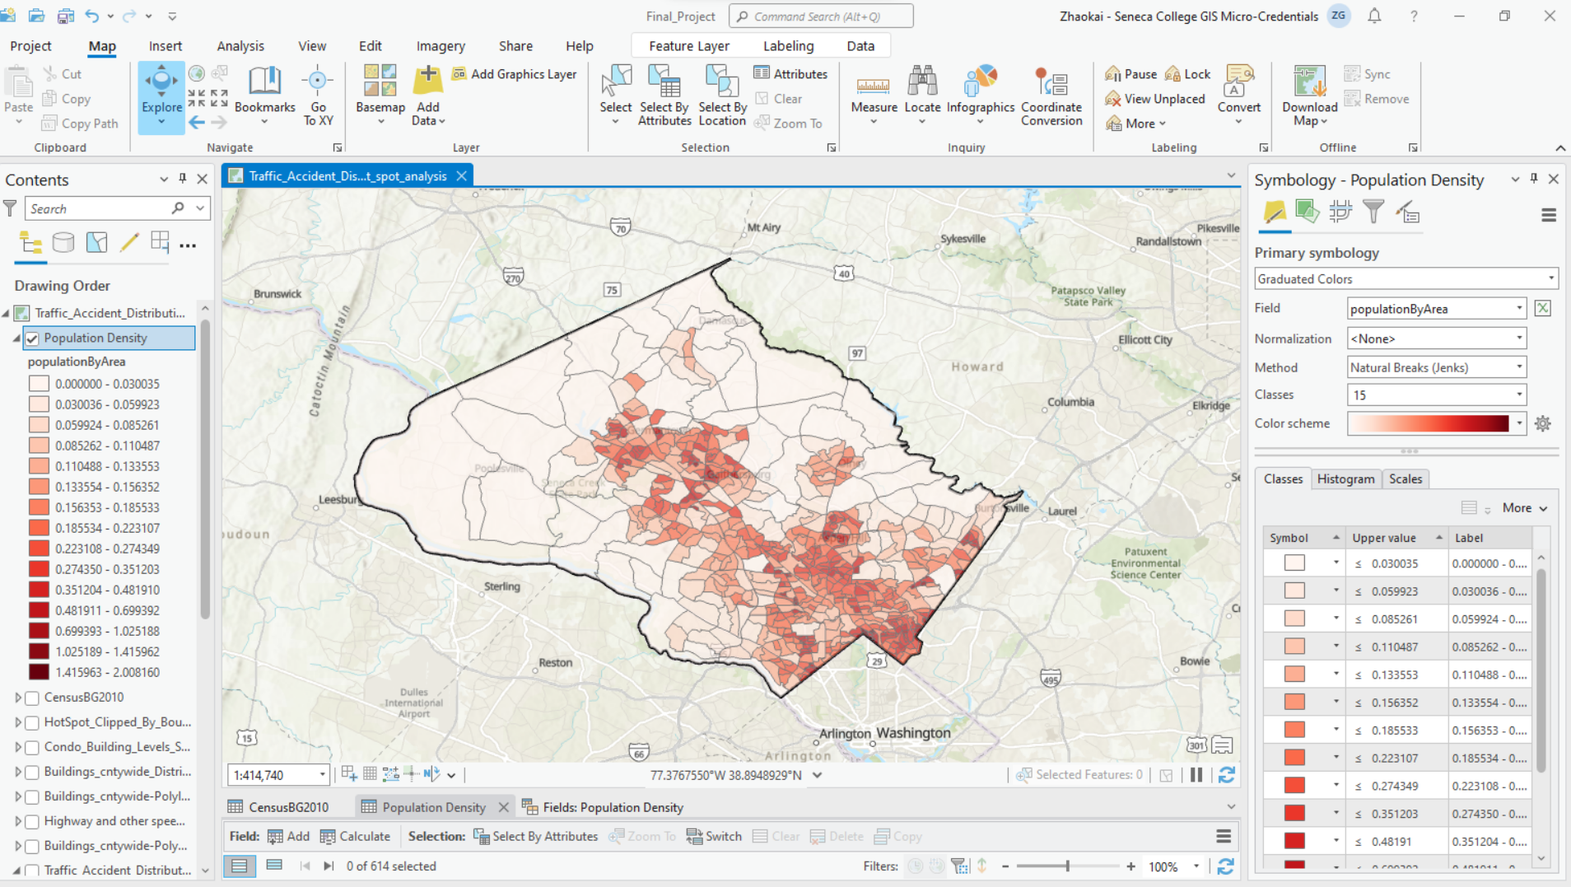
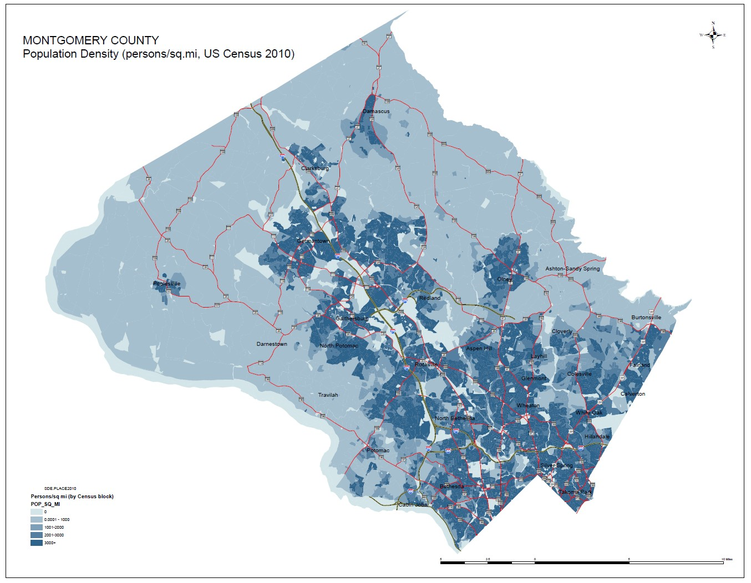
Montgomery Population Density
Made by professional GIS team working for the county.
Made by me

Slide 12
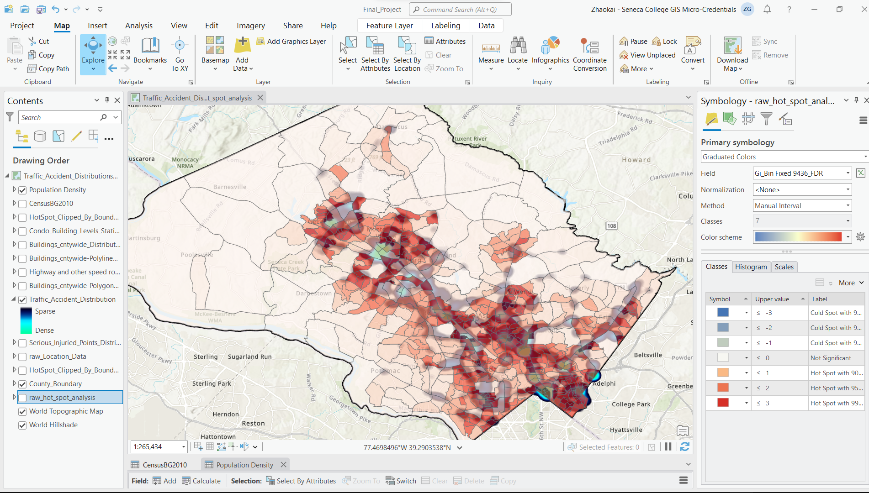

Slide 13
Findings and tasks for furture
It is worth to notice that not all the traffic accident hotspots aligning with the population dense areas. Like the southwest corner of the map, there is a massive hot spot between two districts.
Data analyzing team will be responsible to find out the exact reasons behind all those exceptions.
Combing the power of GIS and machine learn, maybe there will be more lives got saved because of the reduced number of traffic accidents .

Slide 14
Thank you! Looking forward to meet you in person and even working with you in the future!
Feel free to contact me if you have any interesting open-source project.
Zhaokai Guan
zkrguan@gmail.com
https://github.com/zkrguan/
Story Map Link: https://storymaps.arcgis.com/stories/b8f33e993cf2427a9867557fb0019114
Data source link: https://catalog.data.gov/dataset/crash-reporting-drivers-data
GIS open data source link: https://montgomeryplanning.org/tools/gis-and-mapping/data-downloads/
Github link to the forked project: https://github.com/zkrguan/CIND820_capstone

